Slide 1
United Nations Declaration on the Rights of Peasants and Other People Working in Rural Areas (UNDROP): An Introduction
PEOPLE-CENTERED FOOD SYSTEMS
FOSTERING HUMAN RIGHTS BASED APPROACHES
CREDIT: This presentation has been adapted directly from: FIAN International & La Via Campesina. United Nations Declaration on the Rights of Peasants and Other People Working in Rural Areas Introductory Booklet.

Slide 2
WHAT IS IT?
A UN declaration of human rights that recognizes the rights and realities of peasants and rural communities as both individual and collective rights.
An interpretation and application of important human rights conventions (e.g.: the International Covenant on Economic, Cultural and Social Rights) to peasants and peasant. While it reflects the interpretation of human rights conventions adopted by the United Nations General Assembly, the terms of UNDROP are not legally binding.
The product of advocacy, mobilization and negotiations of of peasants and farmers, indigenous people and other rural workers over a 17-year period.

Slide 3
UNDROP
Encourages the support of peasants and other people working in rural areas to enjoy physical and economic access to sufficient and adequate food that is produced and consumed sustainably and equitably, respecting their cultures, preserving access to food for future generations, and that ensures a physically and mentally fulfilling and dignified life for them
Notes:
OPTIONAL (wordy)
Maybe remove

Slide 4
WHO DOES IT REPRESENT?
Peasants and other people working in rural areas who often live in poverty, are denied access to means of production and resources and are highly vulnerable to hunger and malnutrition
Notes:
Notes: Includes artisanal or small

Slide 5
WHO DOES IT REPRESENT (RIGHTS-HOLDERS)?
Peasants | Engage in small-scale agriculture by themselves or in community, for themselves or for the market, who relies primarily on family or non-monetized labor and who relation to the land is one of dependency and attachment
Other rural people | Involved in artisanal or small-scale agriculture, crop planting, livestock raising, pastoralism, fishing, forestry, hunting or gathering, handicrafts related to agriculture or a related occupation in rural areas
 | Indigenous peoples, transhumant, nomadic, landless people, hired workers, migrant workers, seasonal workers

Slide 6
The UNDROP supports:
ACCESS TO HEALTHY FOOD
EDUCATION AND LITERACY
TRADITIONAL AND CULTURAL MEANS OF AGRICULTURE
For peasants and other rural people and their dependents
ACCESS TO SEEDS AND LAND
SAFE AND HEALTHY WORKING CONDITIONS
Notes:
Could use this one only and not next one for duty bearers?

Slide 7
What does UNDROP recognize?
The rights …
1 | Of peasant women and other women working in rural areas | 6 | To food sovereignty (defined as participation in decision-making processes on food & agriculture policy, the right to healthy and adequate food produced through ecologically sound and sustainable methods that respect their cultures) and the collective right to a healthy environment
2 | To seek, receive, develop and impart information, about processing, marketing and distribution of their peasants’ products. | 7 | To an adequate standard of living
3 | To access to justice | 8 | To social security, the right to health and the right to housing
4 | To access to land - it sustainable use, management & protection from arbitrary denial of land access. And, to seeds, biodiversity, water and other natural resources | 9 | To education and the right to adequate training specific and relevant to peasants’ agroecological, sociocultural, and economic environments
5 | To food and the right to be free from hunger | 10 | To enjoy culture and pursue cultural development freely

Slide 8
Origins of UNDROP
2008-2018
2008
2012
La Via Campesina (LVC) adopted the Declaration on the Rights of Peasants, Men and Women
UNHRC established intergovernmental working group called the “UN declaration of peasants and other people working in rural areas” to submit a draft declaration
2018
UNDROP approved by UN General Assembly after 5 sessions of negotiations. UNDROP adopted by 121 states voting in favor, 8 against and 52 abstentions.
Human Rights Council Advisory carried out study on advancement of rights of peasants and other people working in rural areas
Ongoing collaboration between LVC and multiple rights holder groups
2010
2012-2018
Notes:
One of the challenges for UNDROP is that in the General Assembly, all high-income countries except Switzerland either voted against UNDROP or abstained. The opposition tended to focus on issues around rights to land, rights to management of land, fisheries and water that are usually state functions, and technology transfer, among others.
The countries that voted in favour were Afghanistan, Algeria, Angola, Antigua and Barbuda, Azerbaijan, Bahamas, Bahrain, Bangladesh, Barbados, Belarus, Belize, Benin, Bhutan, Bolivia, Botswana, Brunei, Burundi, Cape Verde, Cambodia, Central African Republic, Chad, Chile, Comoros, Congo, Costa Rica, Cuba, Democratic Republic of the Congo, Djibouti, Dominica, Dominican Republic, East Timor, Ecuador, Egypt, El Salvador, Eritrea, Gabon, Gambia, Ghana, Grenada, Guinea, Guinea-Bissau, Guyana, Haiti, India, Indonesia, Iran, Iraq, Ivory Coast, Jamaica, Jordan, Kazakhstan, Kenya, Kuwait, Kyrgyzstan, Laos, Lebanon, Liberia, Libya, Luxembourg, Madagascar, Malawi, Malaysia, Maldives, Mali, Mauritania, Mauritius, Mexico, Moldova, Monaco, Mongolia, Morocco, Mozambique, Myanmar, Namibia, Nepal, Nicaragua, Niger, Nigeria, North Korea, Oman, Pakistan, Panama, Papua New Guinea, Peru, Philippines, Portugal, Qatar, Rwanda, Saint Kitts and Nevis, Saint Lucia, Saint Vincent and the Grenadines, São Tomé and Príncipe, Saudi Arabia, Senegal, Serbia, Seychelles, Sierra Leone, Solomon Islands, Somalia, South Africa, South Sudan, Sri Lanka, Sudan, Suriname, Switzerland, Syria, Tajikistan, Thailand, Togo, Trinidad and Tobago, Tunisia, Uganda, United Arab Emirates, Tanzania, Uruguay, Uzbekistan, Venezuela, Vietnam, Yemen, Zambia and Zimbabwe.
Notably, Australia, Guatemala, Hungary, Israel, New Zealand, Sweden, the United Kingdom and the United States voted against the Declaration.
The countries that abstained were Albania, Andorra, Argentina, Armenia, Austria, Belgium, Bosnia and Herzegovina, Brazil, Bulgaria, Cameroon, Canada, Colombia, Croatia, Cyprus, the Czech Republic, Denmark, Estonia, Ethiopia, Fiji, Finland, France, Georgia, Germany, Greece, Honduras, Iceland, Ireland, Italy, Japan, Kiribati, Latvia, Lesotho, Liechtenstein, Lithuania, Malta, Montenegro, the Netherlands, North Macedonia, Norway, Palau, Poland, South Korea, Romania, Russia, Samoa, San Marino, Singapore, Slovakia, Slovenia, Spain, Turkey, Tuvalu, Ukraine, and Vanuatu.

Slide 9
What UNDROP can do for a country?
Recognize & protect individual and collective human dignity of peasants & rural communities
Improve working conditions of peasants & rural people
Recognize the role of women & girls in small-scale food production
Encourage agro ecology and counter impacts on climate change
Protect peasant seed production systems, biodiversity and ag biodiversity
Protect traditional and cultural knowledge
Notes:
Note to speaker: Can say that even for governments who haven't adopted UNDROP should consider adopting provisions of UNDROP, because they provide guidance about improving the livelihoods and lives of rural people and safeguarding natural resources.
Improve working conditions of peasant & other rural people and related intersectional discrimination based on gender, caste, class, age group, migration status, etc.
Protect traditional and cultural knowledge from privatization, intellectual property policy & law

Slide 10
How can communities use UNDROP?
As a toolbox to tackle discrimination and oppression
Potential to protect rights through national and regional policies
Potential to protect & claim rights through court even if not legally binding
Stay informed of your rights – are they recognized, protected and fulfilled?
Tool to educate about rights and communicate them through other forms of media communication
Tool for advocacy & community organizing
Document violations of human rights
Draft legislation and public policies
Notes:
This slide can be amended depending on audience – duty bearer or rights holder

Slide 11
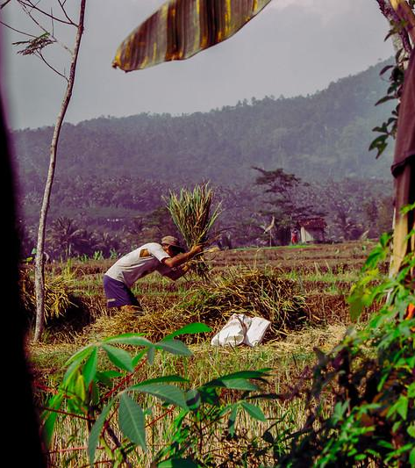
Examples of UNDROP’s use
INDONESIA
Peasants here have been working hard to communicate UNDROP across the country by translating it into local languages, facilitating training and political education events, and relating the Declaration to rights violations on the ground (such as relating Article 17 to the criminalization of a peasant for defending his land). Serikat Petani Indonesia (SPI) have been active in advocating UNDROP as a reference to national laws, such as the Protection and Empowerment of Peasants Law, and the Food Law.

Slide 12
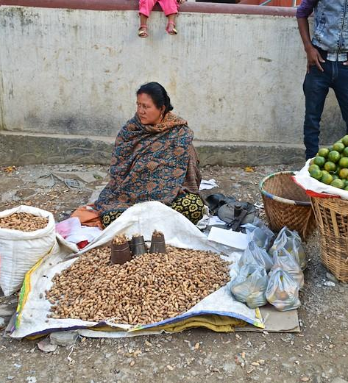
Examples of UNDROP’s use
NEPAL
Peasants in this country have mobilized to advocate for new legislation that protects their rights. The Peasants’ Rights Act is currently in the final stages of ratification at the national level, and it will be the first of its kind in the country.

Slide 13
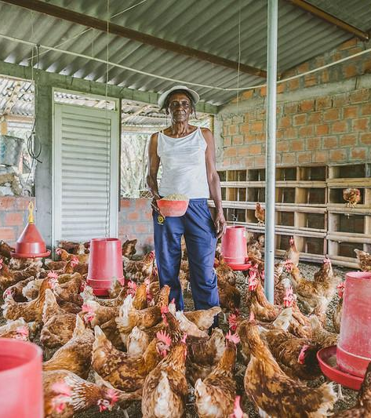
Examples of UNDROP’s use
COLOMBIA
Organizations were able to get the implementation of UNDROP incorporated into the national strategy of the Office of the High Commissioner of Human Rights (OHCHR). From now on, the OHCHR will need to support legislative initiatives advocated by peasants movements and their supporters, as well as document violations to the rights of peasants recognized in UNDROP. In Barrancabermeja, Colombia, women are using UNDROP as a guide to discuss, define and advance towards the implementation of strategies to overcome their concerns over food production, including problems arising from the impact of COVID-19 and lockdown measures.

Slide 14
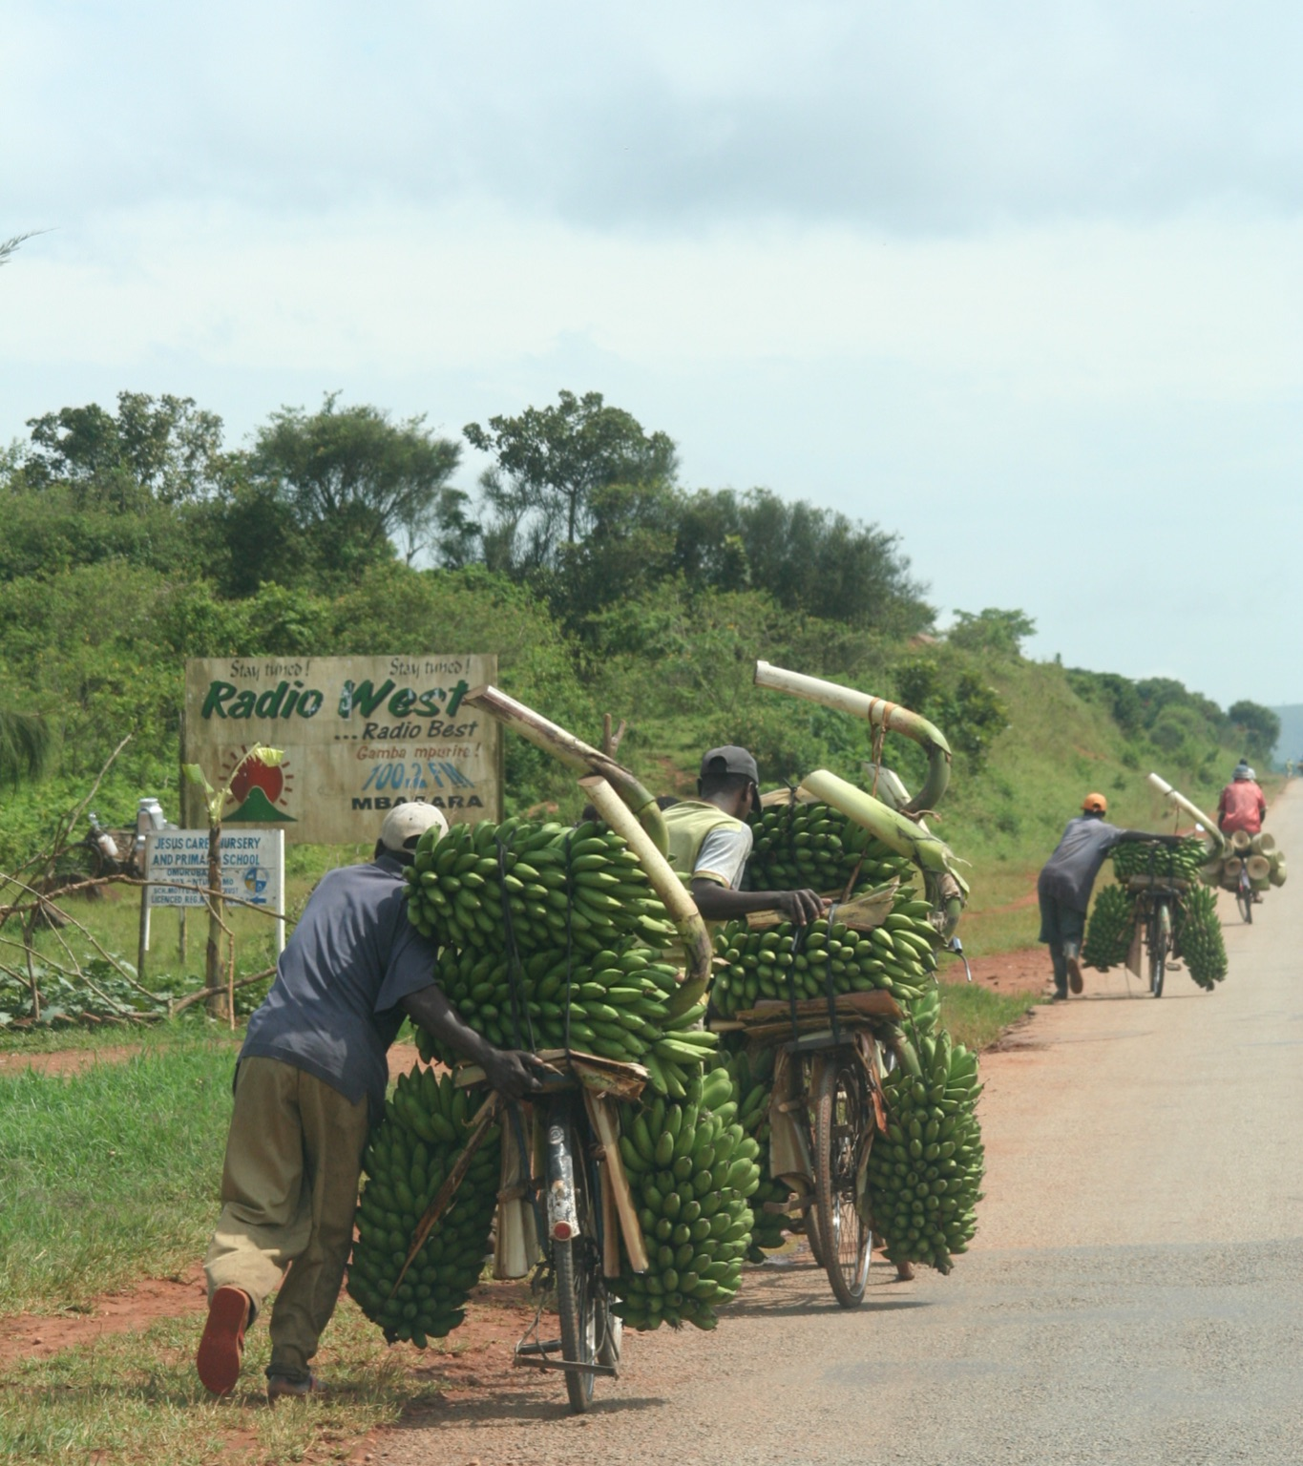
Examples of UNDROP’s use
UGANDA
FIAN Uganda (an ally of LVC) is using UNDROP to advocate for a better fisheries bill that would put the interests of fisher folk above private interests. A position paper supported by various articles of the UNDROP has been submitted to parliament prior to the tabling of the fisheries bill. In Uganda, LVC members have been working hard to communicate the contents of the Declaration, and have found radio to be an important tool to amplify UNDROP.

Slide 15
QUESTIONS?

Slide 16
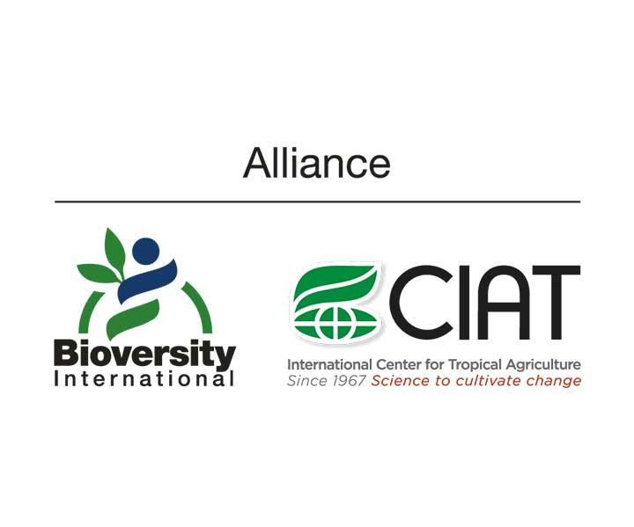
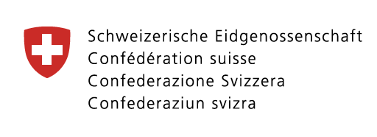
THE CONSORTIUM

