Slide 1
PEOPLE-CENTERED FOOD SYSTEMS
FOSTERING HUMAN RIGHTS BASED APPROACHES

Slide 2
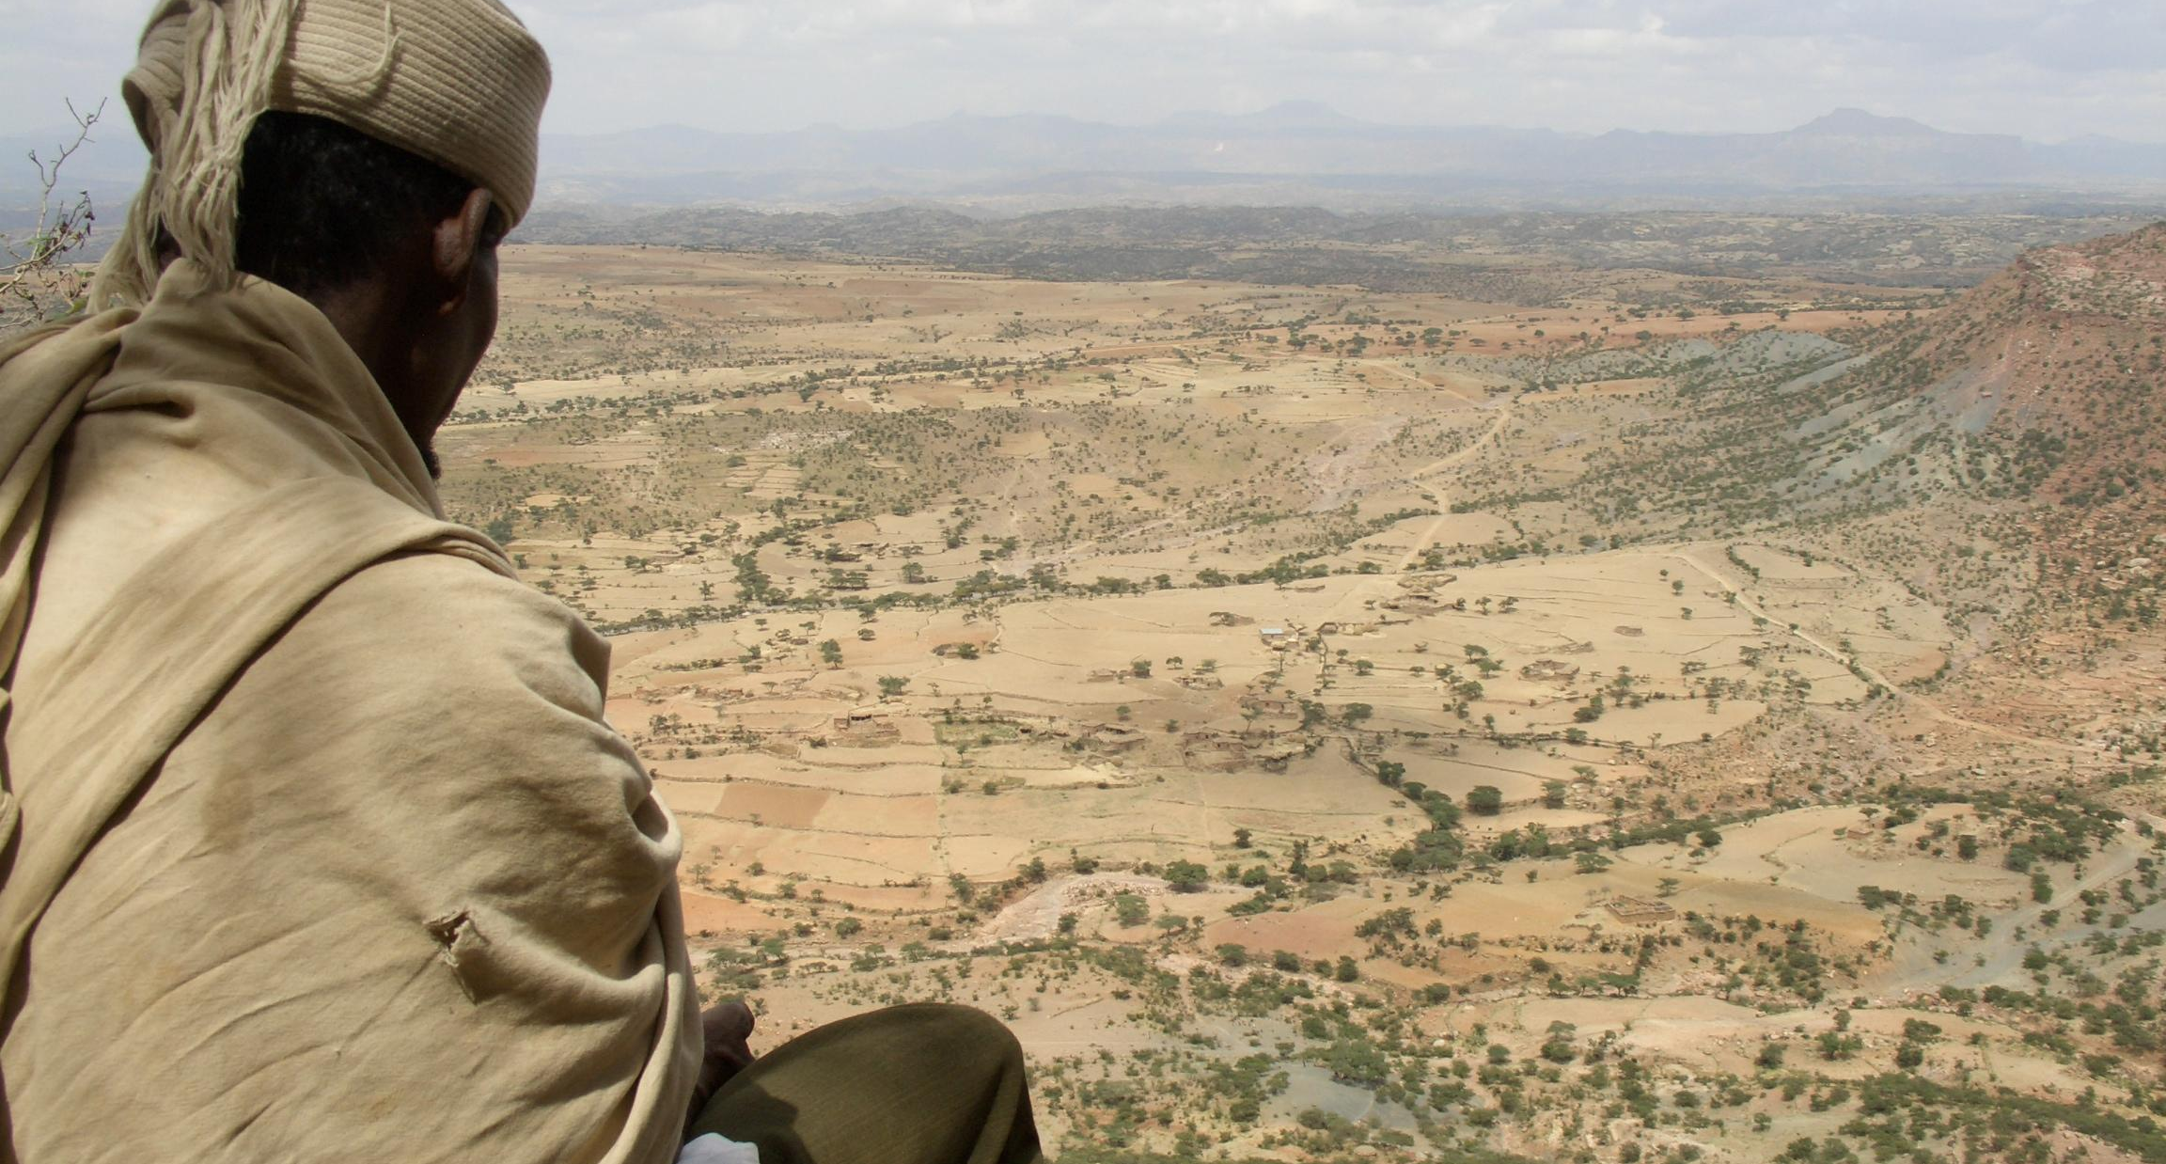
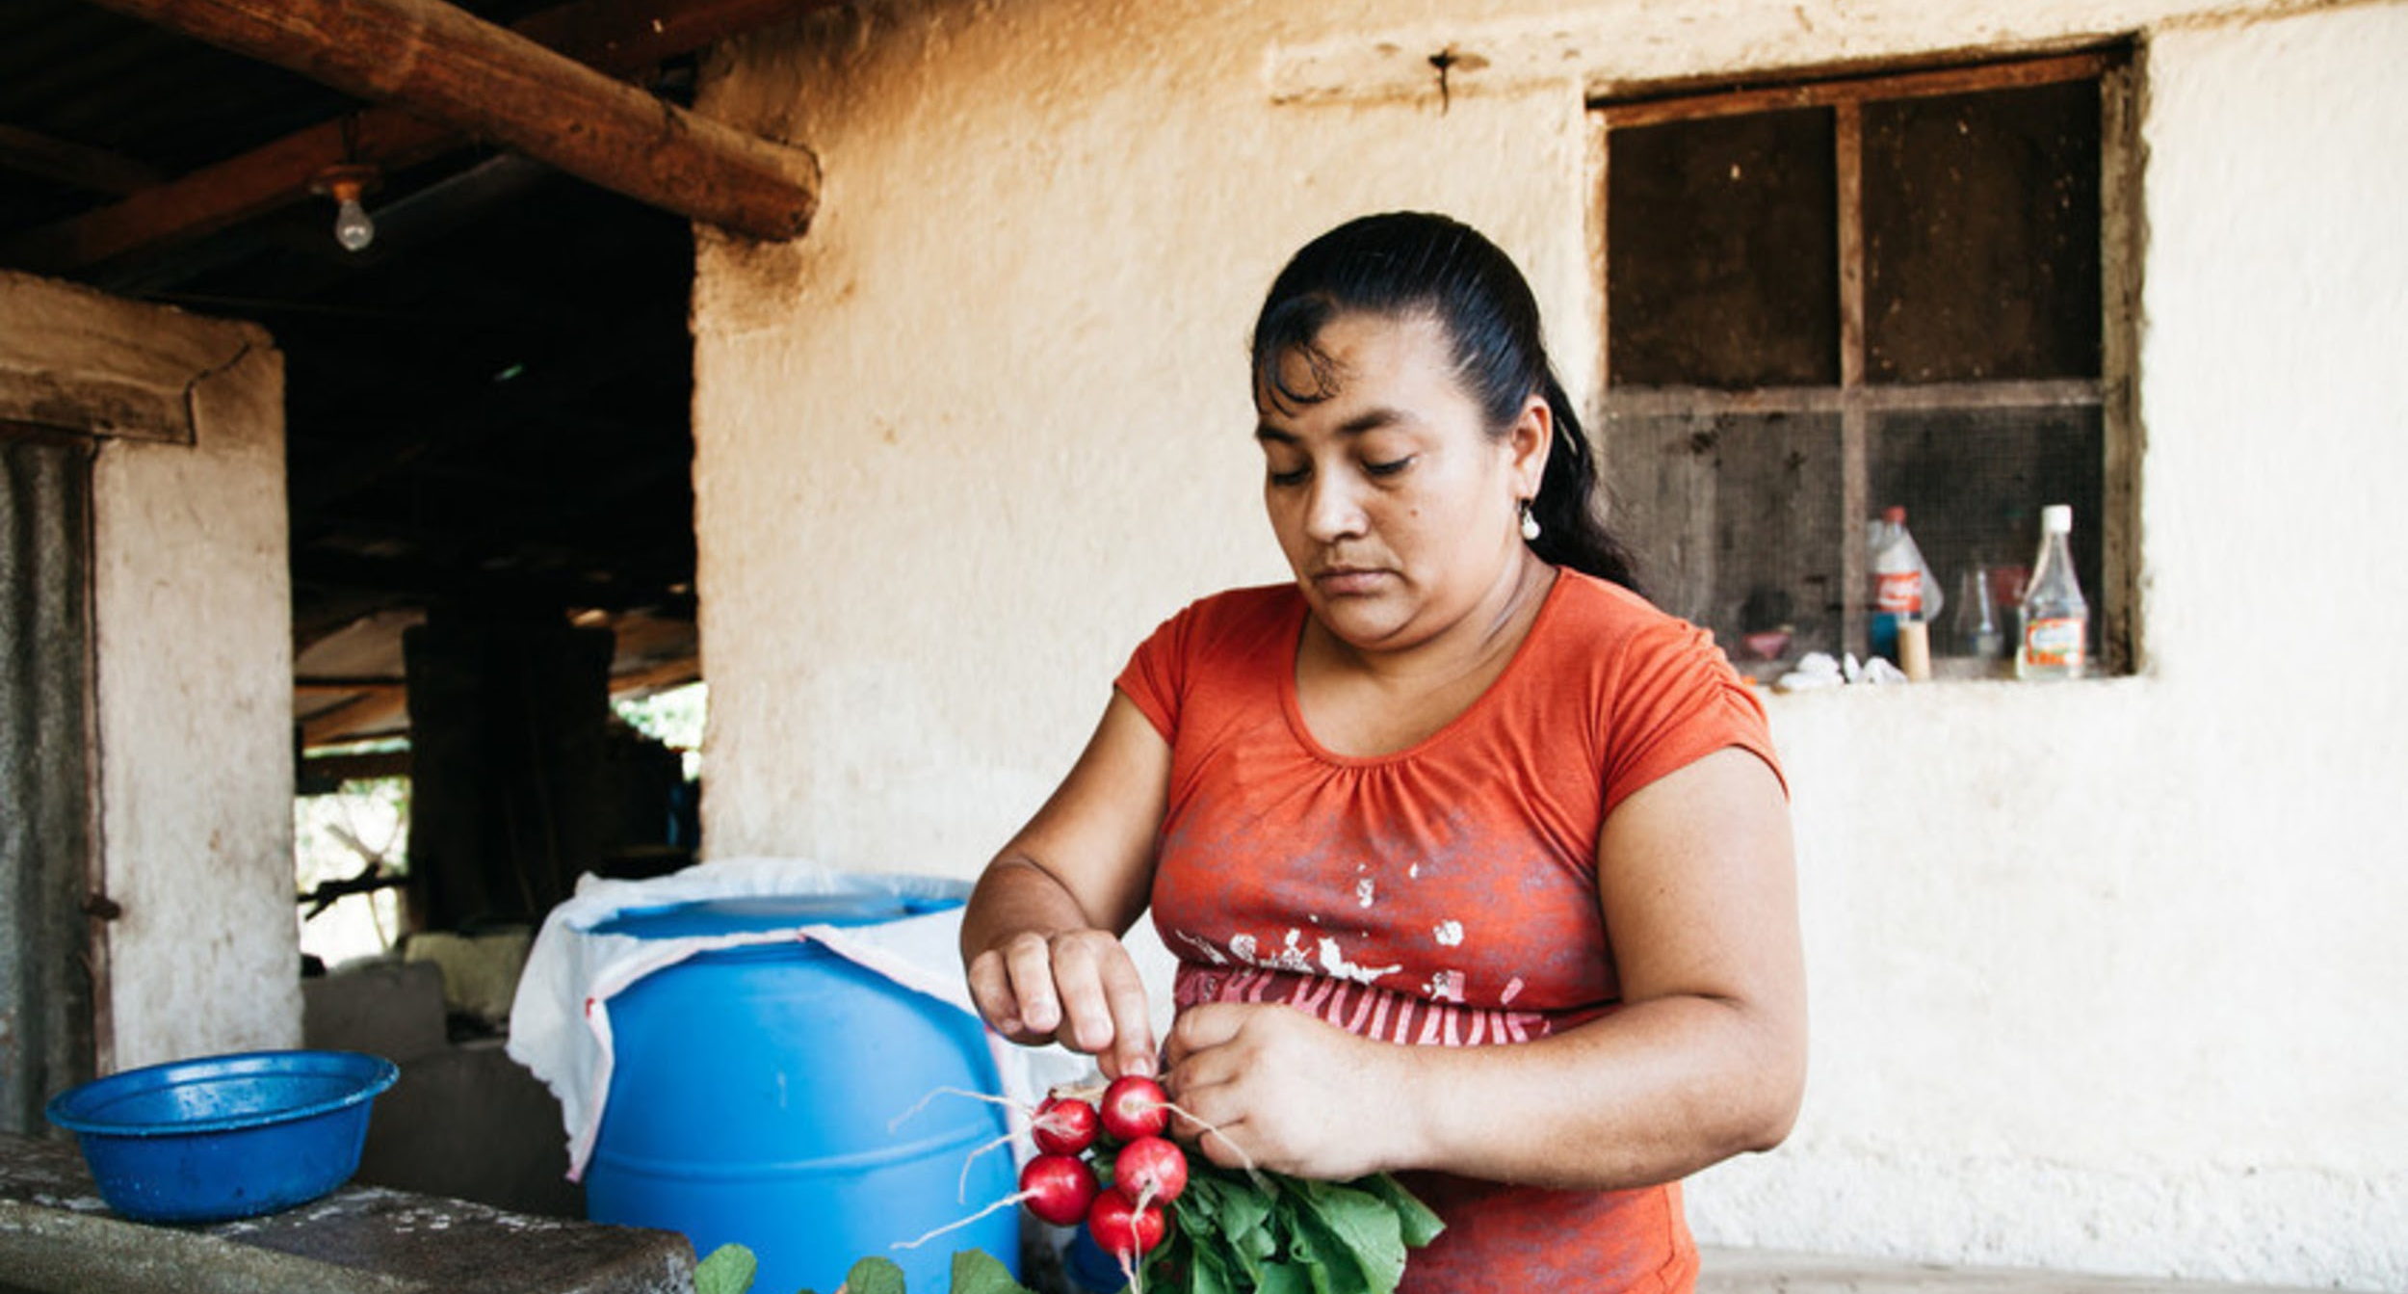
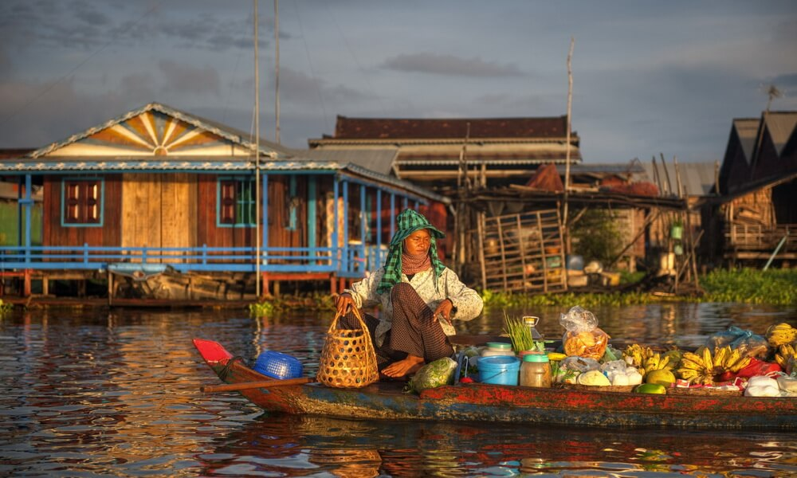
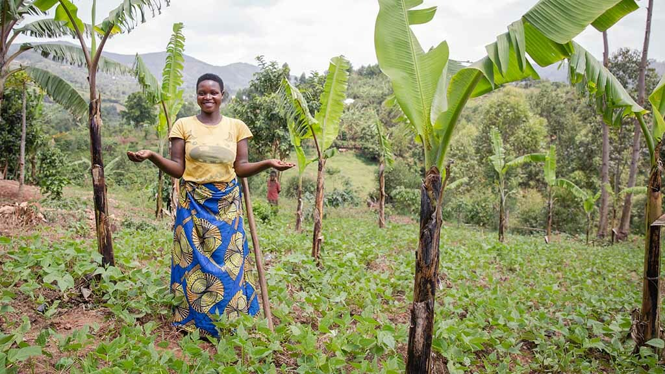
THE CHALLENGE
Identify, characterize, and address constraints that impede marginalized and vulnerable food system actors from:
participating in decisions that inhibit them from realizing their rights to food security, healthy diets and improved nutrition outcomes;
Ethiopia
Honduras
Cambodia
Uganda
adapting to and mitigating against climate change and other food system-related challenges; and
fully contributing to and benefiting from their food systems.

Slide 3
PROJECT GOALS
To support the right-holders and duty bearers in Cambodia, Ethiopia, Honduras, Uganda to better protect the rights of rural and peri-urban food producers living in those countries; and
To help improve their food security and well-being, through a more effective implementation of the UNDROP and the VGFSN, VGGT + VGRTF at sub-national, national, and international levels.

Slide 4
PROJECT APPROACH
Main Goals
Approach
Use advocacy, build capacity, and develop accountability tools that better integrate human rights frameworks within food system policy and action to address ongoing constraints by strengthening the capacity of right-holders
UNDROP
VGs:
Food Systems and Nutrition
VGs:
Land Tenure
VGs:
Right to Food
Notes:
The HLPE framework helps to refocus UNDROP content toward relevant food systems issues while maintaining a connection to human right laws.
The HLPE framework will be framed using two complementary components: (1) the CFS Voluntary Guidelines on Food System for Nutrition (VGFSyN) and (2) an “extended” version of the International Bill of Human Rights
Because the VGFSyN explicitly adopts a food system framework and insists on the importance of using a systemic, intersectoral approach and on context-specific policies, it’s useful as a "prism" for the UNDROP that focuses policy attention on food systems for improved food security, diets and nutrition outcomes. The structure of the VGFSyN into actionable Focus Areas also helps right-holders and stakeholders identify actionable interventions.
We will also use an extended form of the “International Bill of Human Rights” (IBHR) that includes the International Covenant on Civil and Political Rights (ICCPR), and the International Covenant on Economic, Social and Cultural Rights (ICESCR).

Slide 5
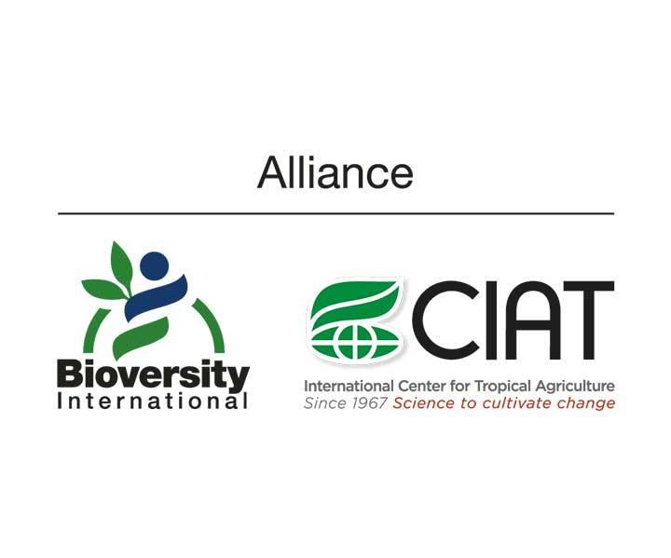
THE CONSORTIUM

Slide 6
PROJECT PHASES
*Uganda, Ethiopia, Honduras, and Cambodia
Phase 1
2021-2025
Establish "enabling environment"
Four pilot countries*
Phase 2
2025-2029
Review & assess
Policy advocacy
Expand to 3-4 more countries
Phase 3
2029-2031
Policy advocacy
Scale up to more countries
Phase 3
2029-2031
Policy advocacy
Scale up to more countries
Notes:
Mention what countries we’re working in. Maybe a

Slide 7
Phase 1: Establishing "Enabling Environment"
2021-2025
Training and building capacity
Creating accountability
Learning; expanding into phases 2 and 3
Training sessions
Mini-courses
Interactive discussions with stakeholders
International accountability workshops
Technical and feedback-reflective workshops
Policy dialogues
Awareness-raising activities
Technical backstopping
Coherence analysis at international and pilot country levels
Mobilizing and raising awareness
Engaging policy coherence

Slide 8
ACTIVITY 1: INFORMATION, KNOWLEDGE AND CAPACITY
What | Increase awareness, access to information and build capacity among national right-holders and beneficiaries to ensure that governments effectively integrate and implement human rights requirements into food systems
How | Series of training sessions Mini-courses Interactive discussions with stakeholders
Who | Small-scale farmers, women and youth working across food systems Policymakers, development partners

Slide 9
ACTIVITY 2: RIGHTS FRAMEWORKS
What | Assist key stakeholders (rights-holders, duty bearers and intervenors) in each pilot country to co-design and build national legal and policy frameworks that supports the effective implementation of national and international instruments based on the right to food and other human rights in the context of food systems.
How | Policy dialogues (consultation workshop with rights' holders and duty bearers) Awareness raising activities Technical backstopping
Who | Small-scale farmers, women and youth working across food systems Civil society, NGOs

Slide 10
ACTIVITY 3: MONITORING AND ACCOUNTABILITY STRENGTHENING
What | Co-design and integrate human rights monitoring and accountability mechanisms specifically adapted to food systems’ conditions in existing M&E systems at both national and international levels.
How | Accountability workshops (international) Technical workshop (accountability) at pilot country level Feedback reflexive workshop
Who | Small-scale farmers, women and youth working across food systems Policymakers and other stakeholders in pilot countries UN agencies

Slide 11
ACTIVITY 4: POLICY COHERENCE
What | Increase the policy coherence between global norm setting processes for food systems and the right to food and UNDROP at national and sub-national levels.
How | Policy coherence analysis at international level Policy coherence analysis at pilot country level
Who | Multiple agencies at both national and international levels

Slide 12
ACTIVITY 5: THEORY-BASED EVALUATION AND LEARNING
What | Develop and implement a theory-based evaluation (TBE) of the project with the objective to document the system-level changes observed around rights-based laws and legislation in the food system, as well as changes in international rights-based norms and guidelines (including around gender).
How | E & L baseline and end line
Who | Project consortium team, country policymakers International fora (to share findings)
Conclusions drawn from E & L will inform and guide the project’s second phase

Slide 13
OUTCOMES
Access to information and the capacity of the right-holders and duty bearers in the four countries and internationally will be improved, so these different stakeholders are in a better position to understand, value and use the UNDROP and VGFSN, VGGT, VGRTF and its food system relevant articles at the benefit of rural and peri-urban food producers and effected populations of those countries.
National legal and policy frameworks supporting the implementation of the UNDROP and its food system relevant articles along with their country-specific road maps successfully drafted through a consultative approach including all relevant stakeholder groups and built on mobilization, participation, and advocacy work.
Monitoring and accountability mechanisms for incorporating human rights in food systems co-developed and integrated into existing national systems and used by organizations and governments to improve programming and implementation of policies, guidelines, and legislations at both national and international levels.
Policy coherence improved at national level between individual sectors/ministries and at international level within the global norm setting processes related to food systems and right to food (e.g., the Committee on Food Security).

Slide 14
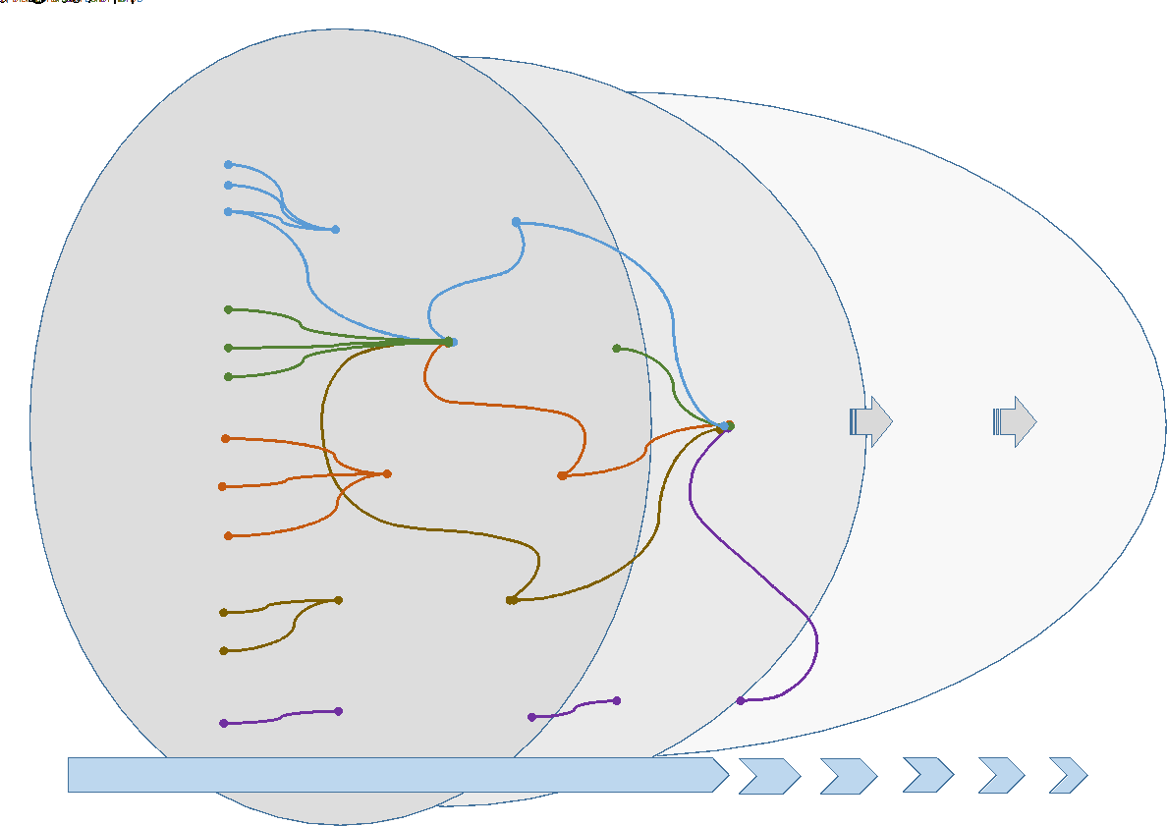
THEORY OF CHANGE

Slide 15
HUMAN RIGHTS FRAMEWORKS
UNDROP
2018 United Nations Declaration on the Rights of Peasants and Other People Working in Rural Areas
VGGT
2017 Voluntary Guidelines on Land Tenure
VGFSN
2021 Voluntary Guidelines on Food Systems and Nutrition
VGRTF
2004 Voluntary Guidelines to Support the Progressive Realization of the Right to Food
Notes:
These activities will address ongoing barriers by strengthening the capacity of right-holders and legitimate key food system actors to better identify, appreciate and address possible constraints.

Slide 16
UNDROP
Encourages the support of peasants and other people working in rural areas to enjoy physical and economic access to sufficient and adequate food that is produced and consumed sustainably and equitably, respecting their cultures, preserving access to food for future generations, and that ensures a physically and mentally fulfilling and dignified life for them
Aims to improve the functioning of markets at the global level and facilitating timely access to market information, including on food reserves, in order to help to limit extreme food price volatility and the attractiveness of speculation

Slide 17
The UNDROP encourages:
ACCESS TO HEALTHY FOOD
EDUCATION AND LITERACY
TRADITIONAL AND CULTURAL MEANS OF AGRICULTURE
For any person engaged in artisanal or small-scale agriculture, crop planting, livestock raising, pastoralism, fishing, forestry, hunting or gathering, and handicrafts related to agriculture and their dependents
ACCESS TO SEEDS AND LAND
SAFE AND HEALTHY WORKING CONDITIONS

Slide 18
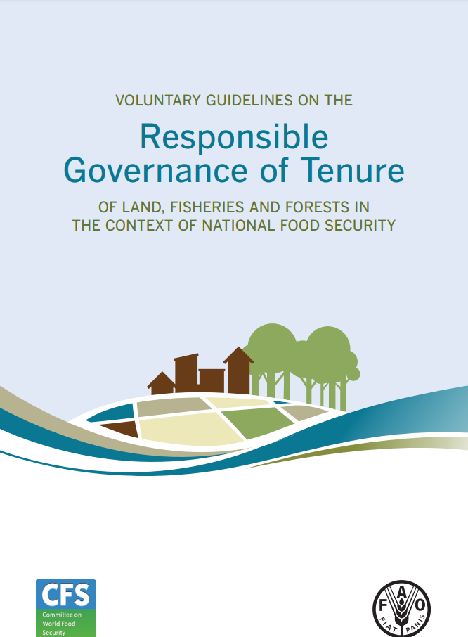
The VGGTs…
improve tenure governance by providing guidance and information on internationally accepted practices for systems that deal with the rights to use, manage and control land, fisheries and forests.
contribute to the improvement and development of the policy, legal and organizational frameworks regulating the range of tenure rights that exist over these resources.
enhance the transparency and improve the functioning of tenure systems.

Slide 19
PRINCIPLES OF IMPLEMENTATION
Human Dignity
Non-discrimination
Equity & Justice
Gender Equality
Holistic & Sustainable Approach
Consultation & Solicitation
Rule of Law
Transparency
Accountability
Continuous Improvement

Slide 20
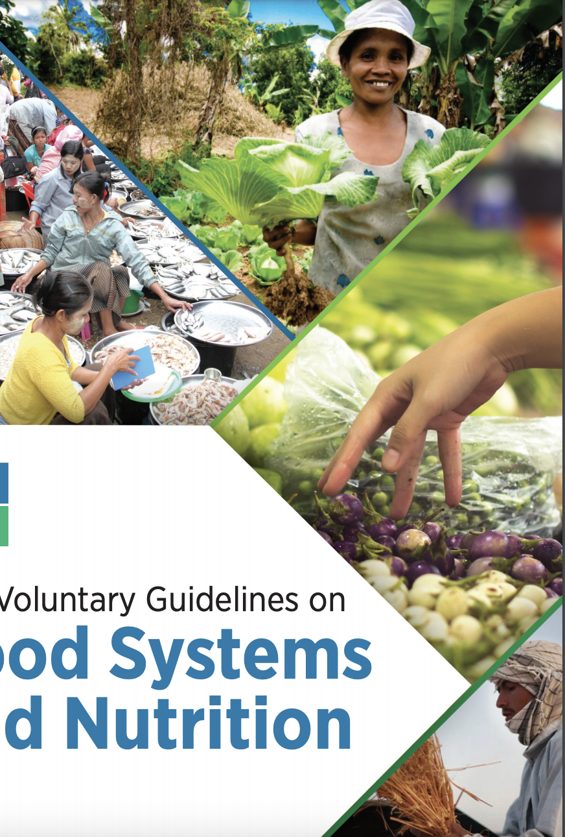
The VGFSNs…
Present a set of science and evidence-based guidelines to achieving healthy diets through sustainable food systems while also addressing economic, social and environmental sustainability issues and impacts.
Provide guidance on appropriate policies, responsible investments and institutional arrangements needed to address the key causes of malnutrition in all its forms from a food systems perspective.
Are non-binding and voluntary.

Slide 21
GUIDING PRINCIPLES
Systemic, multisectoral, science- and evidence-based approach.
Coherent, coordinated, context-specific and inclusive policies.
Accountability, transparency and participation.
Healthy and prosperous people, healthy planet.
Gender equality and women’s empowerment.
Youth empowerment and engagement.

Slide 22
Take your pick! Proposes 105 actions across 7 thematic areas
Transparent, democratic and accountable governance
Sustainable food supply chains to achieve healthy diets in the context of sustainability and climate change
Equal and equitable access to healthy diets through sustainable food systems
Food safety across sustainable food systems
People-centered nutrition knowledge, education and information
Gender equality and women’s empowerment across food systems
Resilient food systems in humanitarian contexts

Slide 23
The VGRTFs…
Aim to guarantee the availability of food in quantity and quality sufficient to satisfy the dietary needs of individuals; physical and economic accessibility for everyone, including vulnerable groups, to adequate food, free from unsafe substances and acceptable within a given culture; or the means of its procurement
provide practical guidance to States in their implementation of the progressive realization of the right to adequate food in the context of national food security

Slide 24
Establish 6 pillars of food security:
Availability
Security of Supply
Access
Utilization
Agency
Sustainability

Slide 25
19 guidelines total, including…
Democracy, good governance, human rights and the rule of law
Economic development policies
Access to resources and assets:
Labor, land, water, genetic resources, sustainability, and services
Food safety and consumer protection
Education and awareness raising
National financial resources
Support for vulnerable groups
National human rights institutions

Slide 26
Key Food Systems Challenges in Cambodia
Inadequate access to...
Land
Affordable healthy diets
Irrigation systems
Climate change
Inequity & issues affecting marginalized communities
Weak advocacy for food systems development
COVID-19-related issues

Slide 27
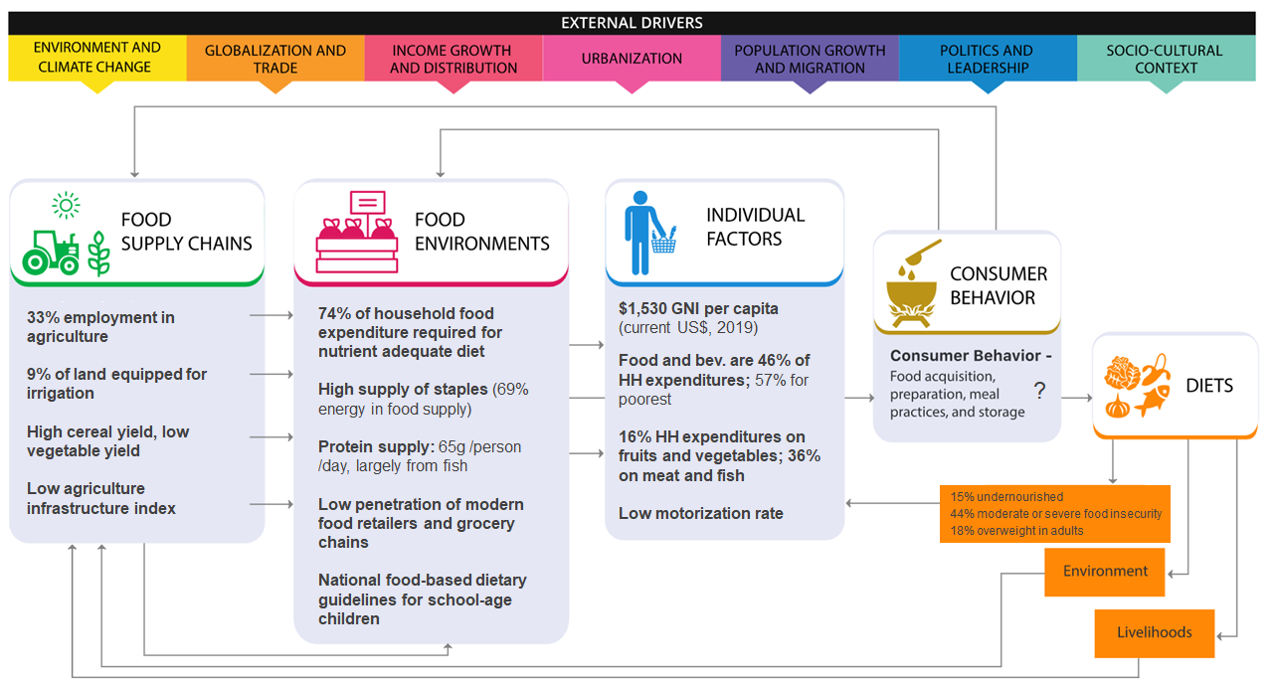
CAMBODIA

Slide 28
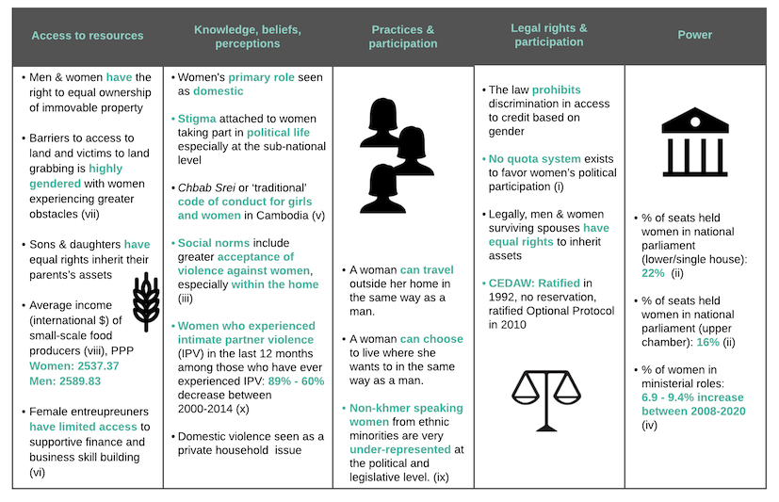
CAMBODIA
(gender analysis)

Slide 29
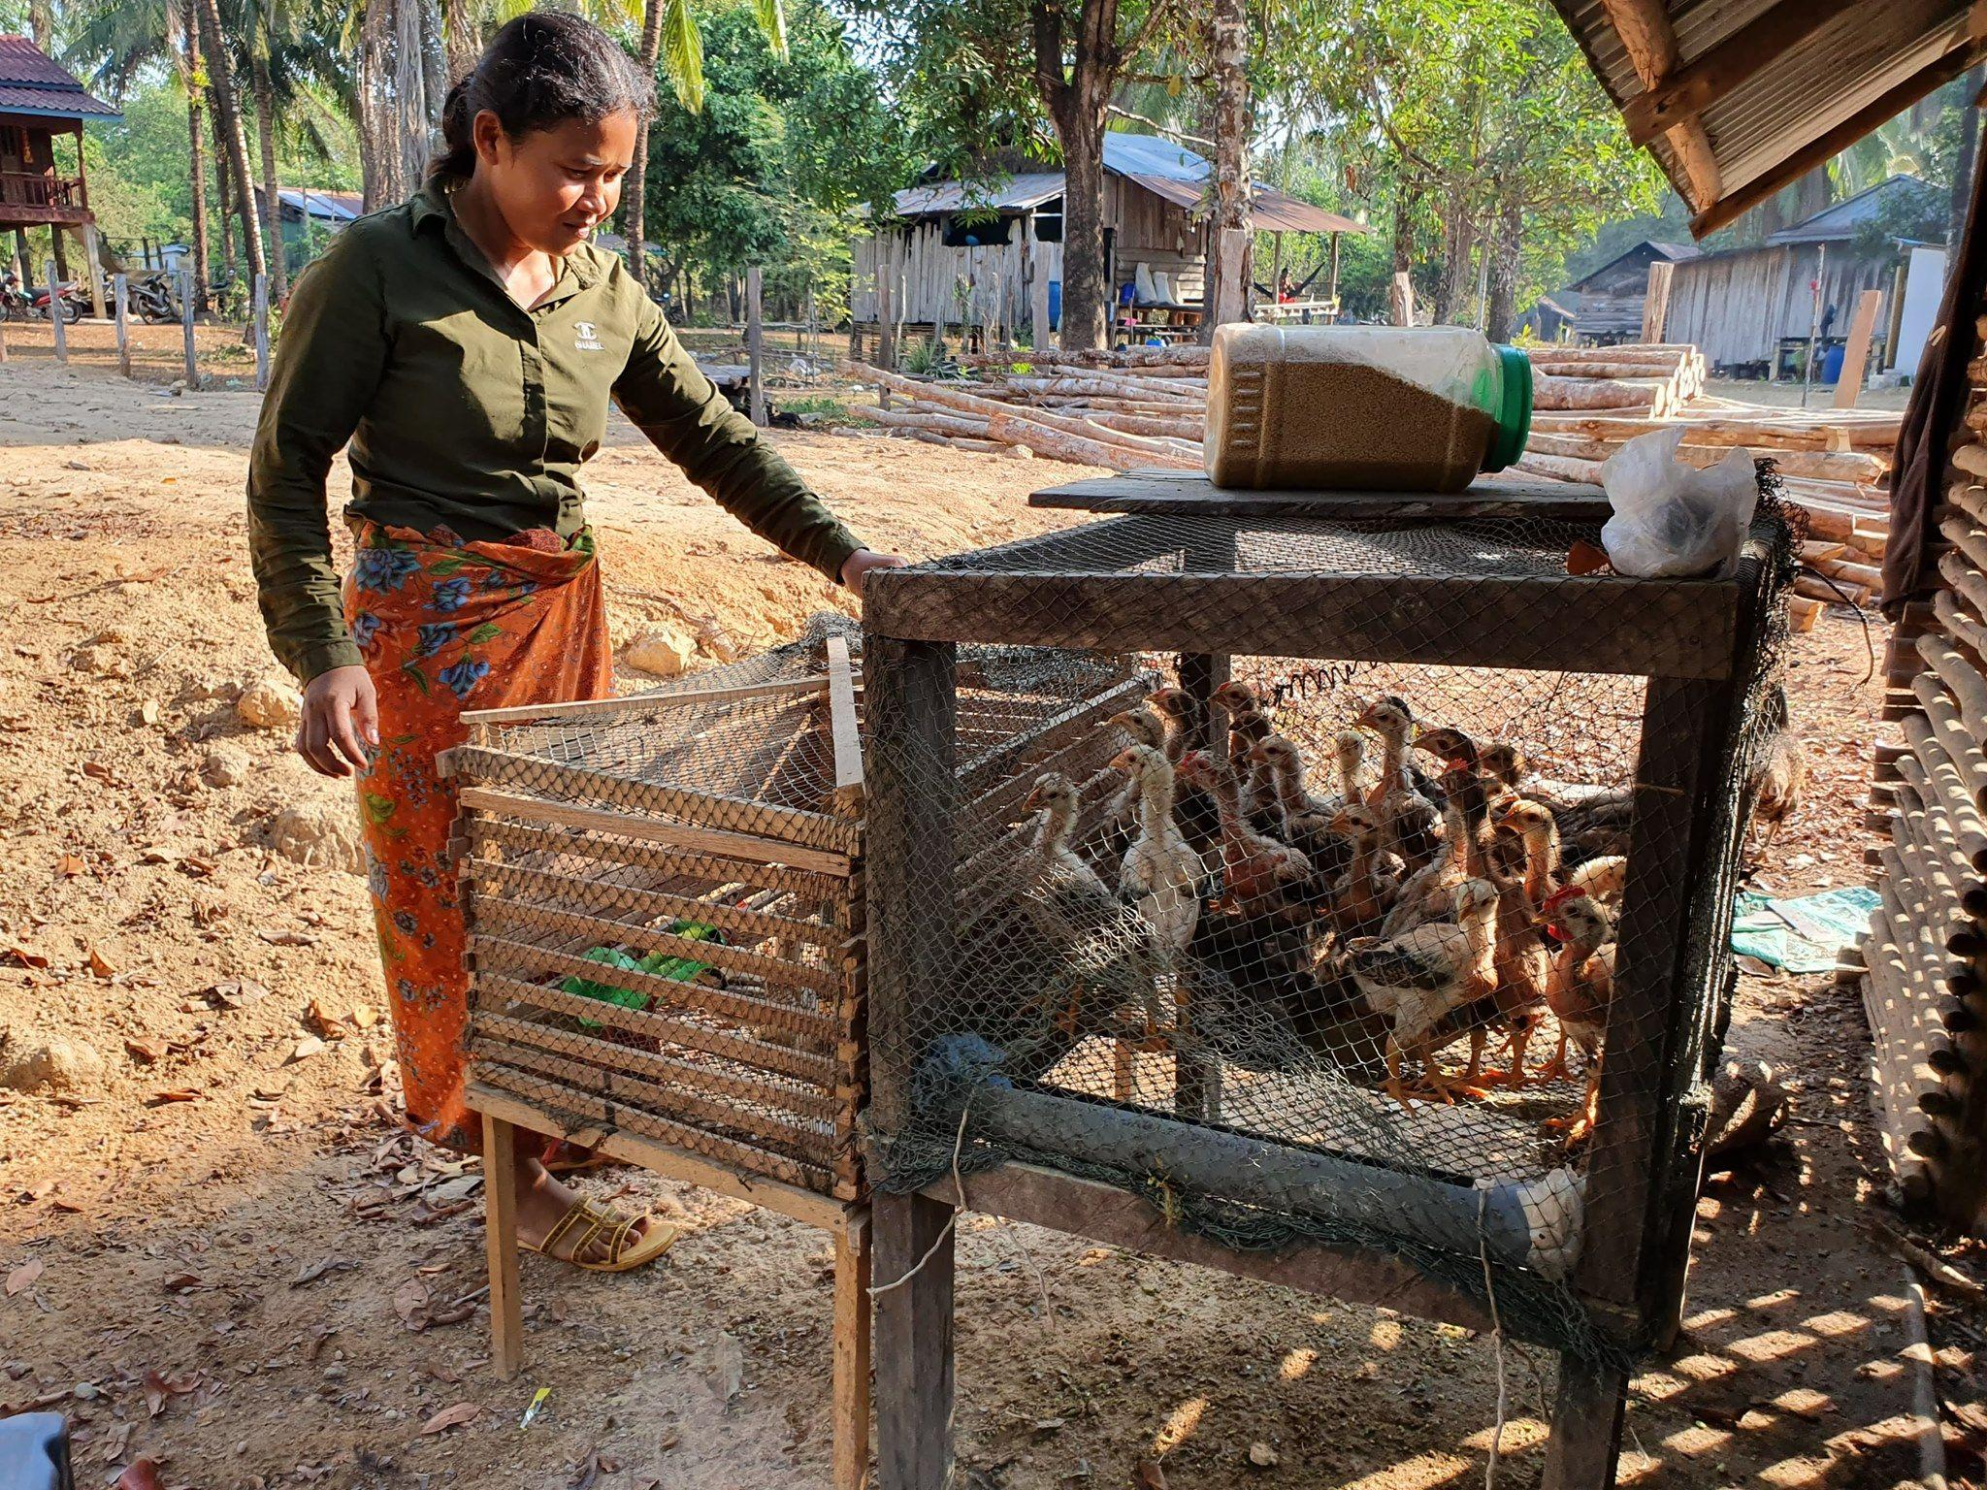
POPULATIONS TO CONSIDER
Women
Pregnant/lactating
Women-led households
Indigenous/ethnic minorities
Highland people
Smallholder or landless/tenant farmers, informal or wage-workers
Notes:
This picture is from IIRR’s website: https://iirr.org/skills-for-success/

Slide 30
Key Food Systems Challenges in Ethiopia
Inadequate access to...
Land
Affordable healthy diets
Heavy reliance on staple crop production & monocropping
Inadequate agricultural sector growth
Weak market linkages
Inequity & issues affecting marginalized communities
COVID-19-related issues

Slide 31
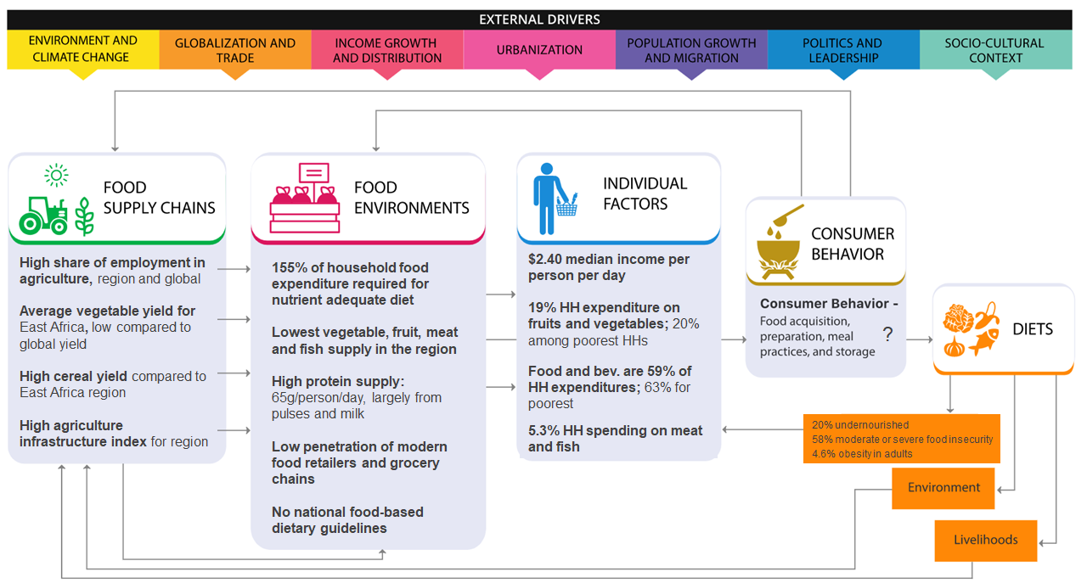
ETHIOPIA

Slide 32
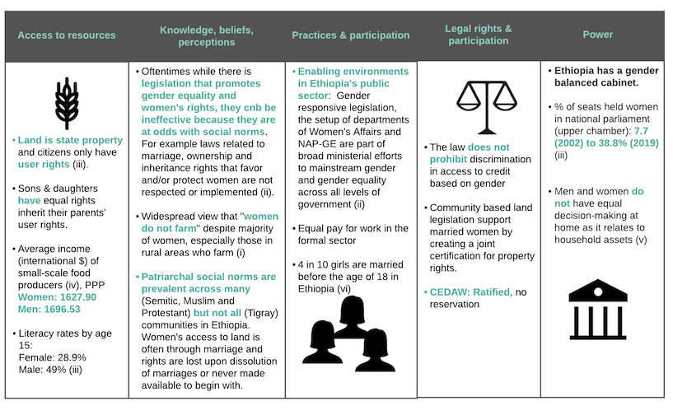
ETHIOPIA
(gender analysis)

Slide 33
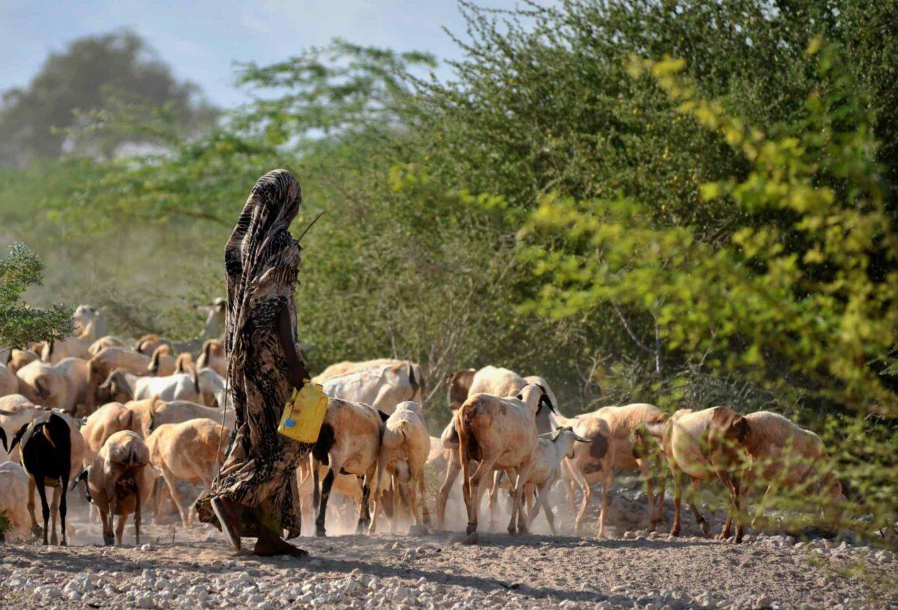
POPULATIONS TO CONSIDER
Women
Youth
Pastoralists
Notes:
https://iirr.org/wp-content/uploads/2021/09/Screen-Shot-2020-05-26-at-8.51.42-PM-1536x797.jpg
https://iirr.org/ethiopia/

Slide 34
Key Food Systems Challenges in Honduras
Climate change
Inadequate access to affordable healthy diets
Gender-related issues
Inadequate food safety mechanisms & enforcement
Weak market linkages & supply chains
Inequity & issues affecting marginalized communities
COVID-19-related issues

Slide 35
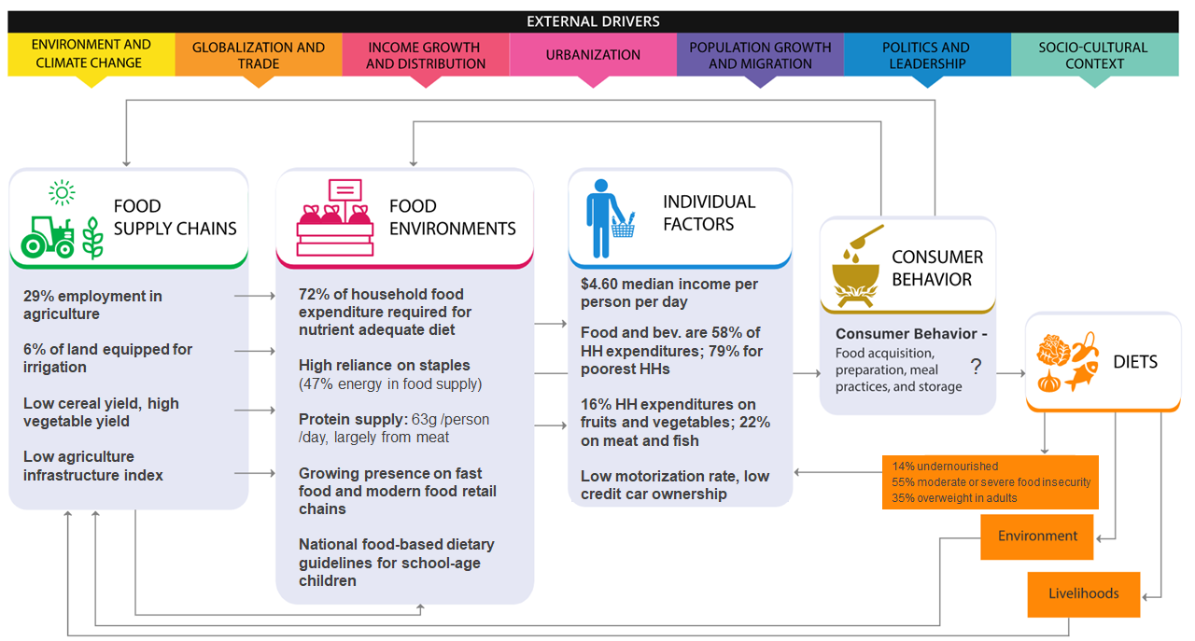
HONDURAS

Slide 36
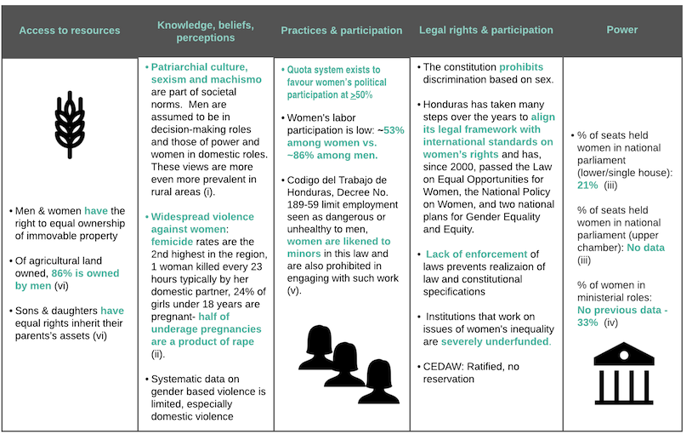
HONDURAS
(gender analysis)

Slide 37
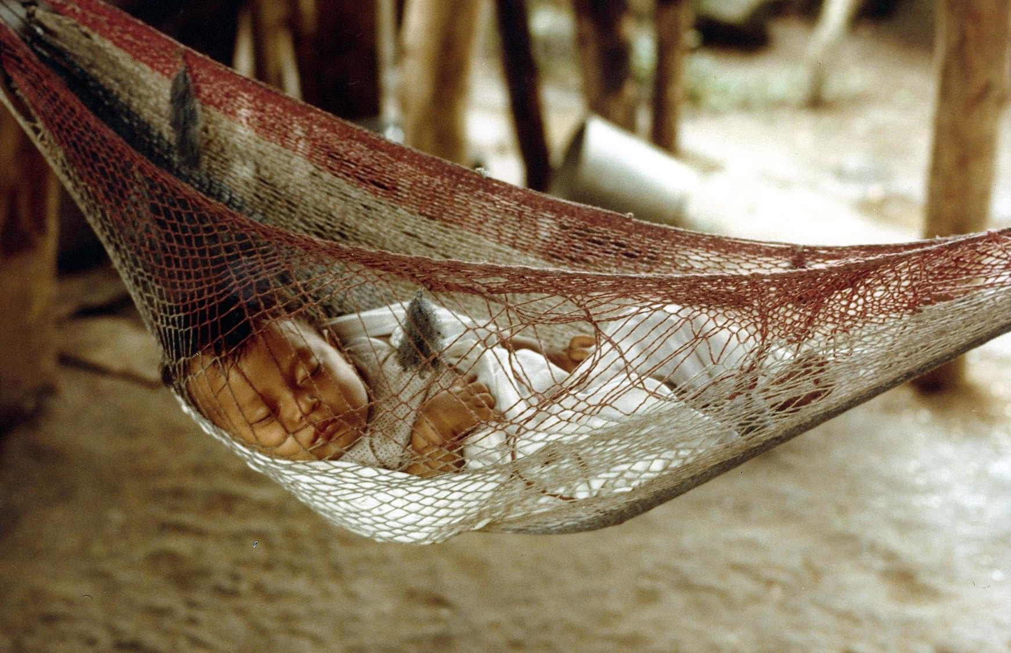
POPULATIONS TO CONSIDER
Women
Indigenous People
Youth
Notes:
https://flic.kr/p/9tdJXv

Slide 38
Key Food Systems Challenges in Uganda
Inadequate access to
Land
Affordable healthy diets
Massive environmental degradation
Inadequate agricultural sector growth
Inadequate food safety mechanisms & enforcement
High burden of disease-related food insecurity & hunger
Weak advocacy for food systems development
COVID-19-related issues

Slide 39
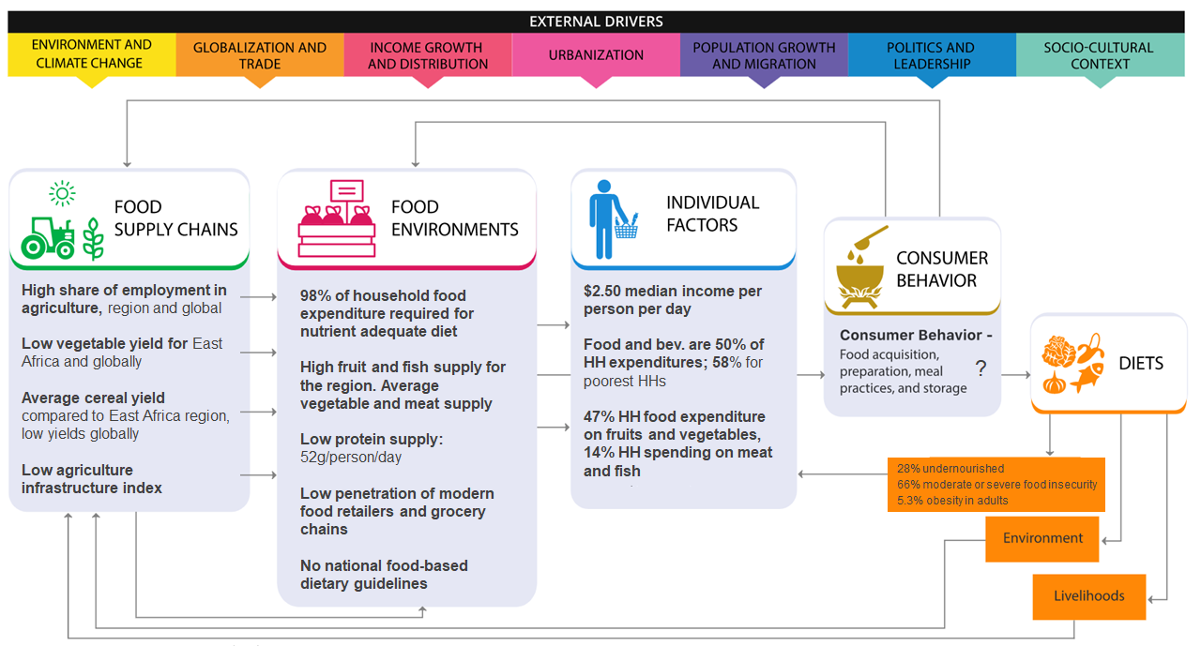
UGANDA

Slide 40
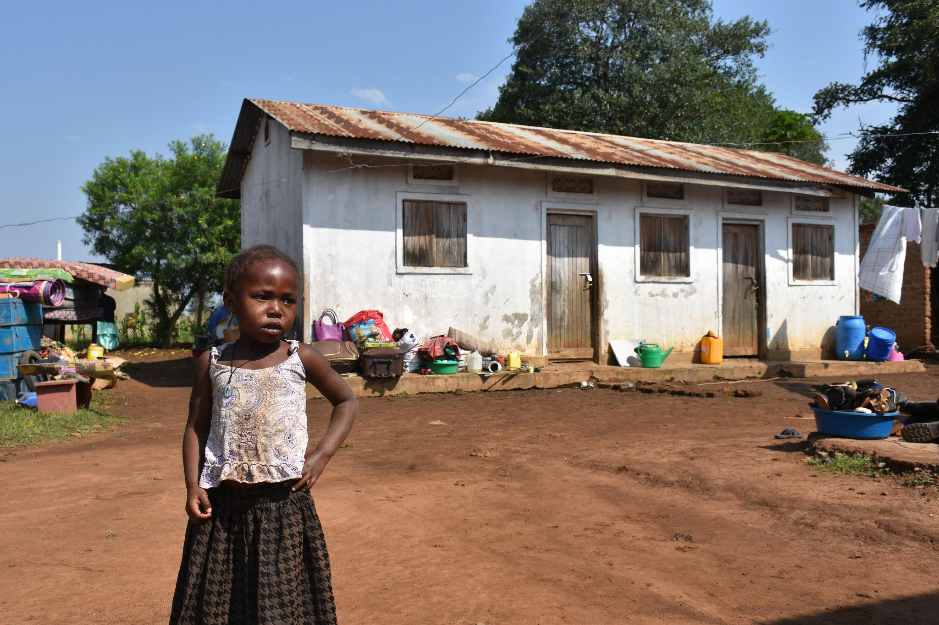
POPULATIONS TO CONSIDER
Women
Pregnant/lactating
Women-led households
Youth
Under 5 and school-aged
Adolescent girls
Ethnic minorities
Notes:
https://flic.kr/p/YwNEjM

Slide 41
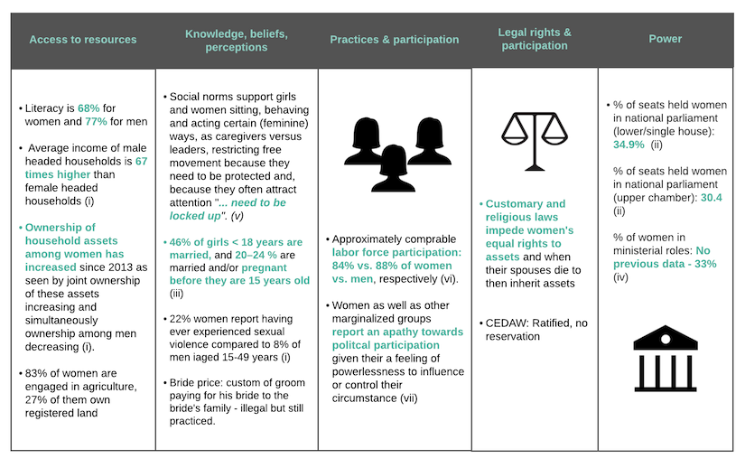
UGANDA
(gender analysis)

