Slide 1
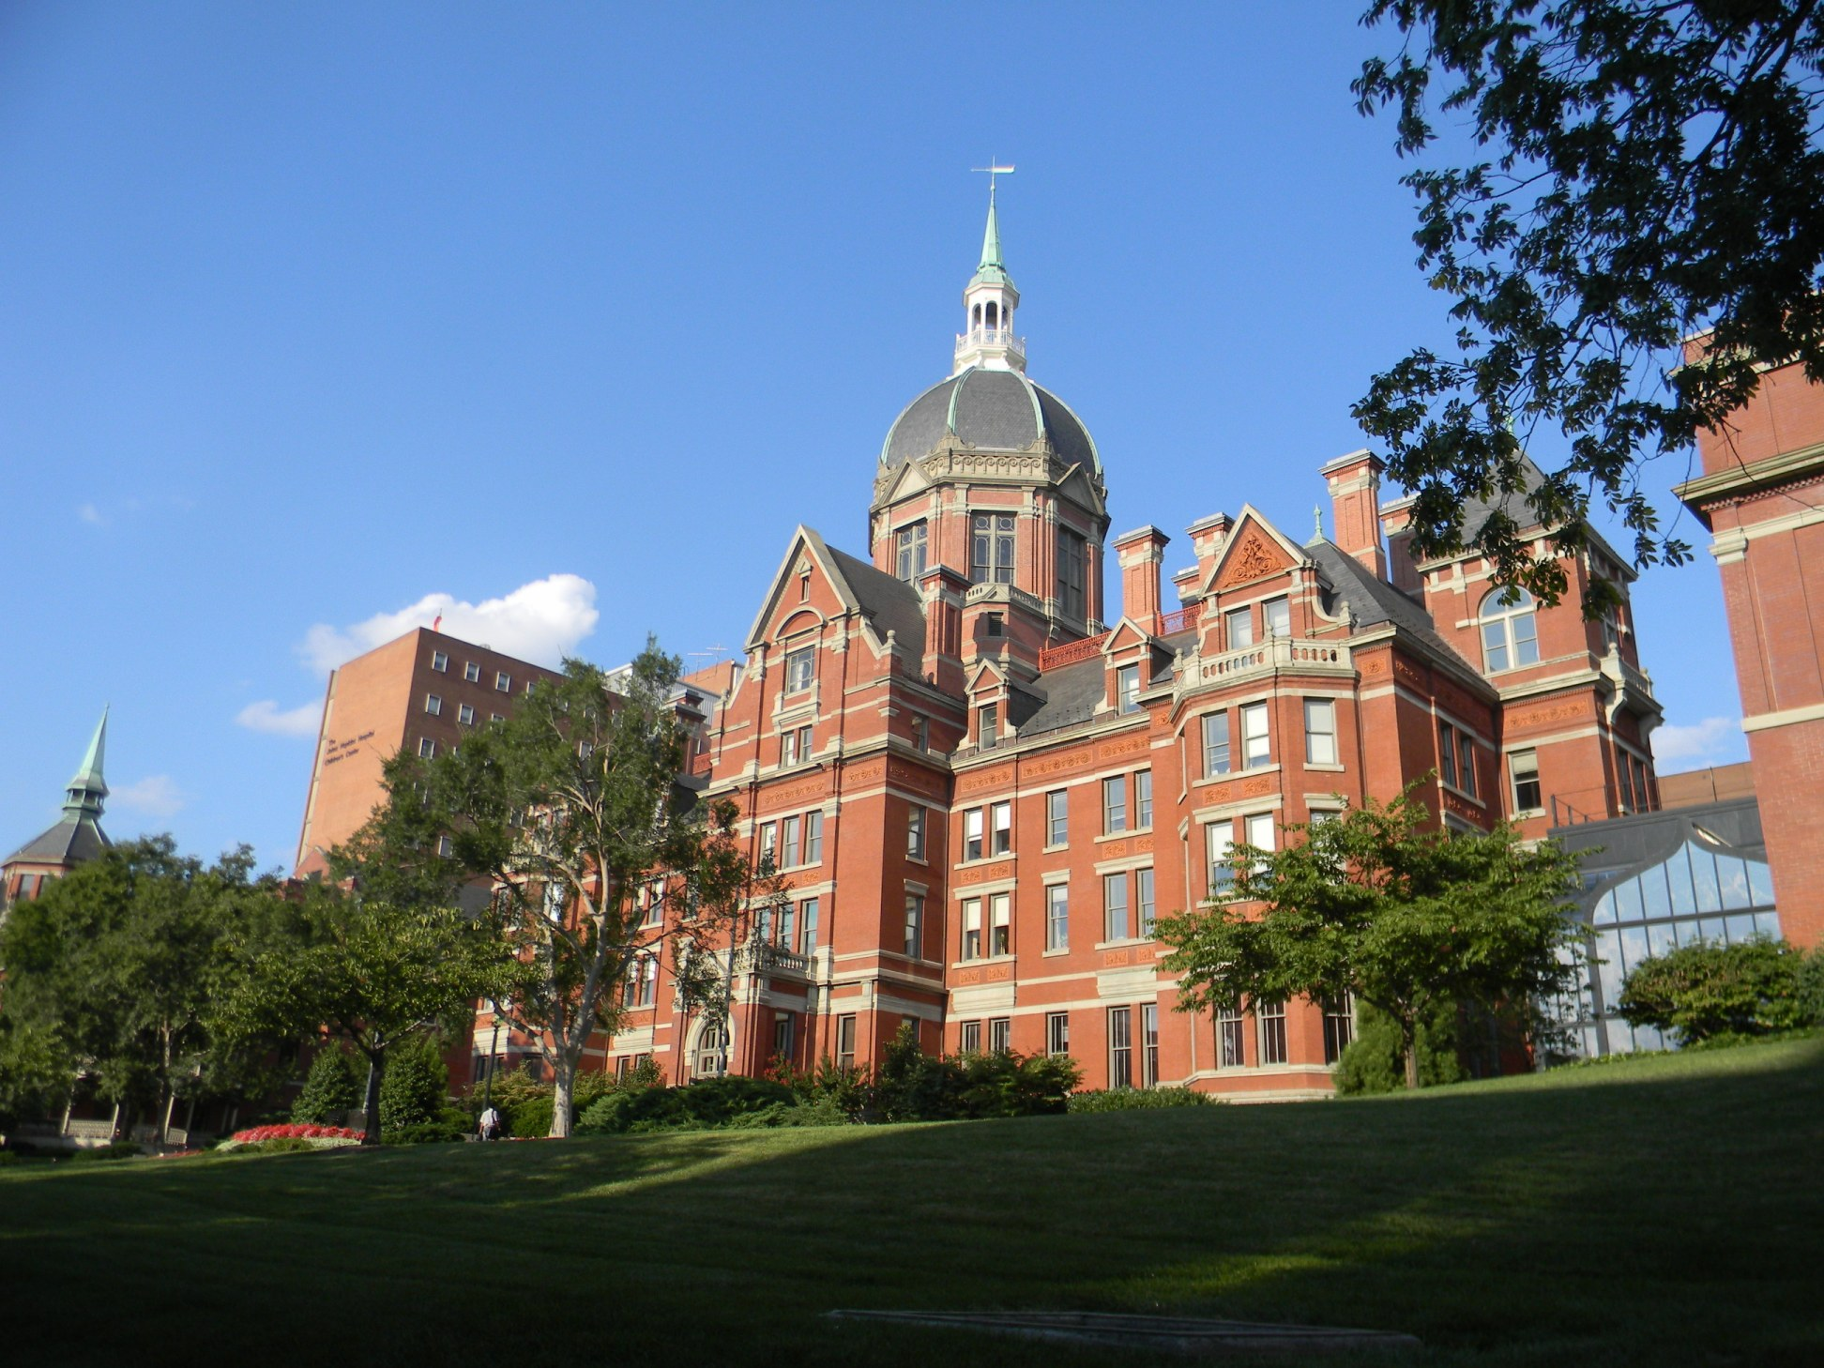
Wilmer Professor Rounds
Ethics and
COVID-19
Megan Collins, MD, MPH
Joe Carrese, MD, MPH
Based on slides by Marielle Gross, MD, MBE, Zack Berger, MD, PhD, and Berman Institute Faculty

Slide 2
Agenda
Logistics 5 minutes
Brief outline of ethical issues --10 minutes
Part 1: Ethical issues for residents --20 minutes
Part 2: Ethical issues for patients and practice --20 minutes
Wrap up - 5 minutes
Summary
Remaining questions
Plan for next steps

Slide 3
Ethical issues
For Practitioners
For Practice
Resource allocation
Worker rights and responsibilities
Moral distress & moral panic
Stigma and racial bias
Individual care vs. public health priorities
Education vs. public health priorities
Essential vs. nonessential care
Resource allocation during scarcity
Telemedicine benefits/limits
Health disparities, stigma/bias
Counseling during uncertainty

Slide 4
Ethical issues
For Practitioners
For Practice
Resource allocation
Availability of PPE
Worker rights and responsibilities
Duty of care
Redeployment
Essential staff/activities
Allocating risks/burdens
Fair division of labor
Personal circumstances
Moral distress & moral panic
Role of social media
Stigma and racial bias
Individual care vs. public health
Education vs. public health
Essential vs. nonessential care
Urgent visits vs routine follow up
Who decides?
Telemedicine benefits/limits
Health disparities, stigma/bias
Resource allocation during scarcity
Counseling during uncertainty

Slide 5
Ethical issues
For Practitioners
For Practice
Resource allocation
Worker rights and responsibilities
Duty of care
Essential staff/activities
Allocating risks/burdens
Fair division of labor
Personal circumstances
Moral distress & moral panic
Role of social media
Stigma and racial bias
Individual care vs. public health priorities
Essential vs. nonessential care
Urgent visits vs routine follow up
Who decides?
Vision vs life-threatening?
Telemedicine benefits/limits
Health disparities, stigma/bias
Vulnerable populations
Resource allocation during scarcity
Counseling during uncertainty

Slide 6
Case Scenarios
For Practitioners

Slide 7
CASE 1
Resident Z has a rheumatologic disease, currently treated with biologics, and is scheduled to covering ED/Consults at Bayview. He is very concerned about potential exposure to COVID-19 as it represents disproportionate risk to his health compared to non-immunocompromised colleagues, especially in this clinical role where he expects to see patients without regular access to PPE. He requests to be moved to a rotation with minimal in-person patient contact.

Slide 8
CASE 1.1
Resident Y returned from parental leave a few weeks ago. Resident X, now on vacation, is called in to cover in place of Resident Y, a resident in the same year, because of concerns of increased risk of spreading COVID 19 to Baby Y and Partner Y.
Resident X, just finished multiple busy clinical and surgical blocks back to back, and was at a physical/mental breaking point, only staved off by the promise of the upcoming 2-week break, which is now cancelled.

Slide 9
CASE 2
Your Asian attending leads inpatient rounds. When the attending introduces themselves to the patient, the patient looks uncomfortable and the patient’s mother blurts out, “I don’t want my daughter or grandchild exposed to the “Chinese virus!” Please find another doctor to take care of my daughter--there must be people on your team who are lower risk!”

Slide 10
Case Scenarios
For Practice

Slide 11
Case 3
A 45 year old woman calls you. You last saw her in GES clinic 9 months ago. She is undocumented and works cleaning hotels. She is the sole provider for three children at home. She has hypertension and DM and follows for diabetic retinopathy. She reports 1 week of cough and now has 48 hours of mild shortness of breath. Her employer has told her that she must come into work and wants a letter from you saying she is healthy enough. She does not have a PCP and asks if you can write the letter.

Slide 12
Case 4
You are a high volume retina specialists, seeing ~50-60 patients/day. Due to the COVID-19 pandemic, you have been asked to reduce your clinic schedule to only emergency patients. While none of your patients are in a life threatening situation, you are concerned about vision threatening consequences of delaying visits.

Slide 13
Case 5
The mother of an ex-24 week premature infant, who is now 37 weeks PMA with Stage 2, Zone 2, pre-plus disease (pre-threshold retinopathy of prematurity (ROP)), is scheduled for 1 week ROP follow-up eye exam. Mom calls to say she’s cancelling the eye appointment because she can’t risk her baby getting COVID-19 since “he only just came home and I don’t want him to die.”

Slide 14
Ethical issues
For Practitioners
For Practice
Resource allocation
Worker rights and responsibilities
Duty of care
Essential staff/activities
Allocating risks/burdens
Fair division of labor
Personal circumstances
Cohorting?
Moral distress & moral panic
Role of social media
Stigma and racial bias
Individual care vs. public health priorities
Practical guidance for minimizing nonessential patient contact
Essential vs. nonessential care
Urgent visits vs routine follow up
Who decides?
Telemedicine benefits/limits
Health disparities, stigma/bias
Resource allocation during scarcity
Counseling during uncertainty
Notes:
Update?

Slide 15
Questions? mcolli36@jhmi.edu jcarrese@jhmi.edu

